Slide 1
TURMorIC: Adding Some Spice to Brain Cell Imaging
Team
Members: Sergio Mayta, Muna Yase, Colin Landis, Krista Phommatha, Heather Wood

Slide 2
Background

Slide 3


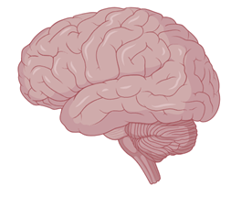
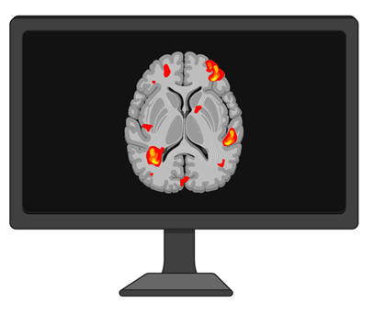

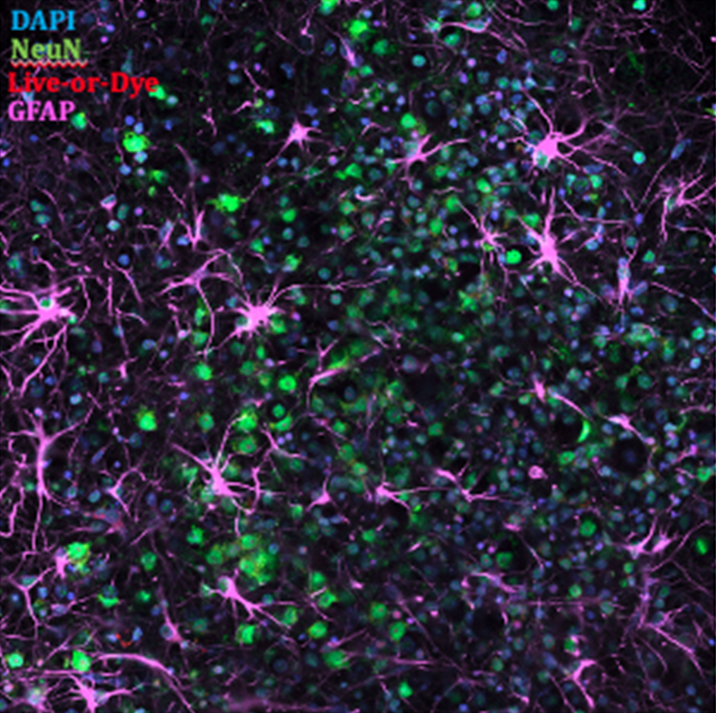
Brain Cell Imaging

Slide 4
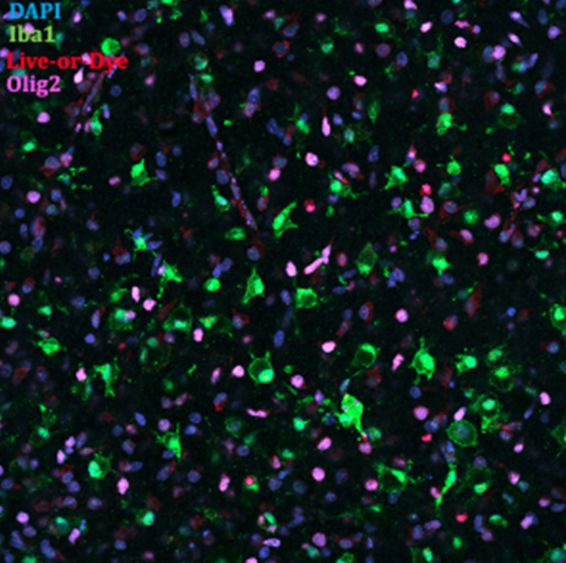
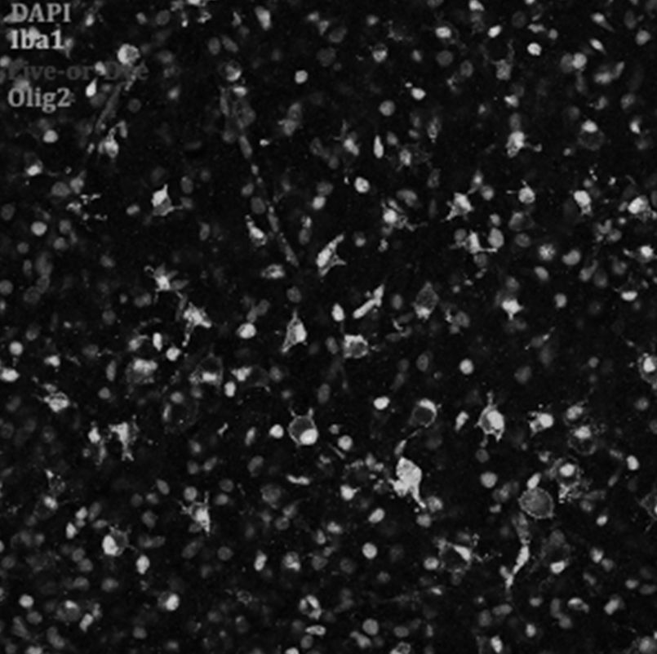

Visually Aided Morpho-Phenotyping Image Recognition

Slide 5

Introducing TURMorIC
Tools for Understanding and Recognizing Morphology of Imaged Cells

Slide 6
Design

Slide 7
Layout of software and components
Image Preprocessing
–Prepares raw microscopy images for segmentation and analysis
Path to folder containing raw images
Experiment metadata
(optional) User-defined parameters

Slide 8
Layout of software and components
Adaptive Thresholding
–Adjusts thresholding parameters based on intensity variations
Image Preprocessing
–Removes background noise, adjusts contrast, normalizes variations
–Splits images into 4 quadrants
–Splits data into train and test sets
Path to folder containing raw images
Experiment metadata
Preprocessed images
(optional) User-defined parameters
Segmentation & Quantification
–Segments images based on thresholding parameters and ground truth data
Ground truth data (testing set)

Slide 9
Layout of software and components
Adaptive Thresholding
–Applies thresholding methods to images
–Finds optimal threshold for microglia identification
Threshold values
Reference datasets
Preprocessed images
Segmentation parameters
Segmentation & Quantification
–Segments images based on thresholding parameters and ground truth data

Slide 10
Layout of software and components
Adaptive Thresholding
–Applies thresholding methods to images
–Finds optimal threshold for microglia identification
Adaptive Thresholding
–Applies thresholding methods to images
–Finds optimal threshold for microglia identification
Adaptive Thresholding
–Applies thresholding methods to images
–Finds optimal threshold for microglia identification
Preprocessed images
Segmentation parameters
Segmentation & Quantification
–Detects glial cells in images and extracts morphological features
Datasets with morphological feature calculations
Ground truth data (testing set)
Segmented images
Segmentation overlays

Slide 11
Layout of software and components
Adaptive Thresholding
Batch Processing
–Enables researchers to process many images in one run
Image Preprocessing
Segmented images & statistical summaries
Segmentation & Quantification

Slide 12
GUI Components
MainWindow
- Allows the user to interact with the system easily
-Takes care of input validation and error handling
- Users desire convenience by having the system remember settings

Slide 13
GUI Components
MainWindow
- Allows the user to interact with the system easily
-Automatically takes care of input validation and error handling
- Users desire convenience by having the system remember settings
MainWindow
-Displays control panels, status indicators, and data visualization
-Takes inputs from the user and processes them to communicate with system components
- Saves user preferences

Slide 14
GUI Components
MainWindow
- Allows the user to interact with the system easily
-Automatically takes care of input validation and error handling
- Users desire convenience by having the system remember settings
MainWindow
-Displays control panels, status indicators, and data visualization
-Takes inputs from the user and processes them to communicate with system components
- Saves user preferences
CentralNode
-Users want smooth and efficient coordination between operations
-Users expect the system to organize data in a logical, consistent manner

Slide 15
GUI Components
MainWindow
- Allows the user to interact with the system easily
-Automatically takes care of input validation and error handling
- Users desire convenience by having the system remember settings
MainWindow
-Displays control panels, status indicators, and data visualization
-Takes inputs from the user and processes them to communicate with system components
- Saves user preferences
CentralNode
-Users want smooth and efficient coordination between operations
-Users expect the system to organize data in a logical, consistent manner
- Minimal interruption to the user experience
CentralNode
-Distributes instructions from the UI to the appropriate worker threads
-Manages storage of processed data and organizes file paths for easy access and retrieval

Slide 16
GUI Components
ImageHandler
-Users expect rapid visual feedback
-Users want a seamless transition from image editing to storage
MainWindow
- Allows the user to interact with the system easily
-Automatically takes care of input validation and error handling
- Users desire convenience by having the system remember settings
MainWindow
-Displays control panels, status indicators, and data visualization
-Takes inputs from the user and processes them to communicate with system components
- Saves user preferences
MainWindow
-Displays control panels, status indicators, and data visualization
-Takes inputs from the user and processes them to communicate with system components
- Saves user preferences
CentralNode
-Ensure smooth and efficient coordination between multiple operations
-Users expect the system to organize data in a logical, consistent manne
- Minimal interruption to the user experience
CentralNode
-Distributes instructions from the UI to the appropriate worker threads
-Manages storage of processed data and organizes file paths for easy access and retrieval

Slide 17
GUI Components
ImageHandler
-Users expect rapid visual feedback
-Users want a seamless transition from image editing to storage
ImageHandler
-Alters images according to specific user-defined operations
-Processes images and stores them in accessible manner
MainWindow
- Allows the user to interact with the system easily
-Automatically takes care of input validation and error handling
- Users desire convenience by having the system remember settings
MainWindow
-Displays control panels, status indicators, and data visualization
-Takes inputs from the user and processes them to communicate with system components
- Saves user preferences
MainWindow
-Displays control panels, status indicators, and data visualization
-Takes inputs from the user and processes them to communicate with system components
- Saves user preferences
CentralNode
-Ensure smooth and efficient coordination between multiple operations
-Users expect the system to organize data in a logical, consistent manne
- Minimal interruption to the user experience
CentralNode
-Receives instructions from UI and sends them to workers
-Manages data storage and file paths
- Starts and stops thread processes
CentralNode
-Distributes instructions from the UI to the appropriate worker threads
-Manages storage of processed data and organizes file paths for easy access and retrieval

Slide 18
GUI Components
ImageHandler
-Users expect rapid visual feedback
-Users want a seamless transition from image editing to storage
ImageHandler
-Alters images according to specific user-defined operations
-Processes images and stores them in accessible manner
MainWindow
- Allows the user to interact with the system easily
-Automatically takes care of input validation and error handling
- Users desire convenience by having the system remember settings
MainWindow
-Displays control panels, status indicators, and data visualization
-Takes inputs from the user and processes them to communicate with system components
- Saves user preferences
MainWindow
-Displays control panels, status indicators, and data visualization
-Takes inputs from the user and processes them to communicate with system components
- Saves user preferences
CentralNode
-Ensure smooth and efficient coordination between multiple operations
-Users expect the system to organize data in a logical, consistent manne
- Minimal interruption to the user experience
CentralNode
-Receives instructions from UI and sends them to workers
-Manages data storage and file paths
- Starts and stops thread processes
CentralNode
-Distributes instructions from the UI to the appropriate worker threads
-Manages storage of processed data and organizes file paths for easy access and retrieval
FunctionHandler
-Users need to calculate metrics for analysis & models
-Users expect to receive outputs in an organized format

Slide 19
GUI Components
ImageHandler
-Calls functions that alter images
-Processes images and sends them to CentralNode
ImageHandler
-Alters images according to specific user-defined operations
-Processes images and stores them in accessible manner
MainWindow
-Displays control panels, status indicators, and data visualization
-Takes inputs from the user and processes them to communicate with system components
- Saves user preferences
MainWindow
-Displays control panels, status indicators, and data visualization
-Takes inputs from the user and processes them to communicate with system components
- Saves user preferences
CentralNode
-Receives instructions from UI and sends them to workers
-Manages data storage and file paths
- Starts and stops thread processes
CentralNode
-Distributes instructions from the UI to the appropriate worker threads
-Manages storage of processed data and organizes file paths for easy access and retrieval
FunctionHandler
-Handles auxiliary operations (PCA)
-Sends processed outputs to CentralNode

Slide 20
GUI Components
ImageHandler
-Users expect rapid visual feedback
-Users want a seamless transition from image editing to storage
ImageHandler
-Calls functions that alter images
-Processes images and sends them to CentralNode
ImageHandler
-Alters images according to specific user-defined operations
-Processes images and stores them in accessible manner
MainWindow
- Allows the user to interact with the system easily
-Automatically takes care of input validation and error handling
- Users desire convenience by having the system remember settings
MainWindow
-Displays control panels, status indicators, and data visualization
-Takes inputs from the user and processes them to communicate with system components
- Saves user preferences
MainWindow
-Displays control panels, status indicators, and data visualization
-Takes inputs from the user and processes them to communicate with system components
- Saves user preferences
CentralNode
-Ensure smooth and efficient coordination between multiple operations
-Users expect the system to organize data in a logical, consistent manne
- Minimal interruption to the user experience
CentralNode
-Receives instructions from UI and sends them to workers
-Manages data storage and file paths
- Starts and stops thread processes
CentralNode
-Distributes instructions from the UI to the appropriate worker threads
-Manages storage of processed data and organizes file paths for easy access and retrieval
FunctionHandler
-Users need to calculate metrics for analysis & models
-Users expect to receive outputs in an organized format
FunctionHandler
-Handles auxiliary operations (PCA)
-Sends processed outputs to CentralNode
ModelHandler
-Users need a method to automatically categorize data based on features

Slide 21
GUI Components
ImageHandler
-Users expect rapid visual feedback
-Users want a seamless transition from image editing to storage
ImageHandler
-Calls functions that alter images
-Processes images and sends them to CentralNode
ImageHandler
-Alters images according to specific user-defined operations
-Processes images and stores them in accessible manner
MainWindow
- Allows the user to interact with the system easily
-Automatically takes care of input validation and error handling
- Users desire convenience by having the system remember settings
MainWindow
-Displays control panels, status indicators, and data visualization
-Takes inputs from the user and processes them to communicate with system components
- Saves user preferences
MainWindow
-Displays control panels, status indicators, and data visualization
-Takes inputs from the user and processes them to communicate with system components
- Saves user preferences
CentralNode
-Ensure smooth and efficient coordination between multiple operations
-Users expect the system to organize data in a logical, consistent manne
- Minimal interruption to the user experience
CentralNode
-Receives instructions from UI and sends them to workers
-Manages data storage and file paths
- Starts and stops thread processes
CentralNode
-Distributes instructions from the UI to the appropriate worker threads
-Manages storage of processed data and organizes file paths for easy access and retrieval
FunctionHandler
-Users need to calculate metrics for analysis & models
-Users expect to receive outputs in an organized format
FunctionHandler
-Handles auxiliary operations (PCA)
-Sends processed outputs to CentralNode
FunctionHandler
-Handles auxiliary operations (PCA)
-Sends processed outputs to CentralNode
BuildModel
-Users need a method to automatically categorize data based on features
ModelHandler
-Builds or applies clustering algorithm based on morphological parameters

Slide 22
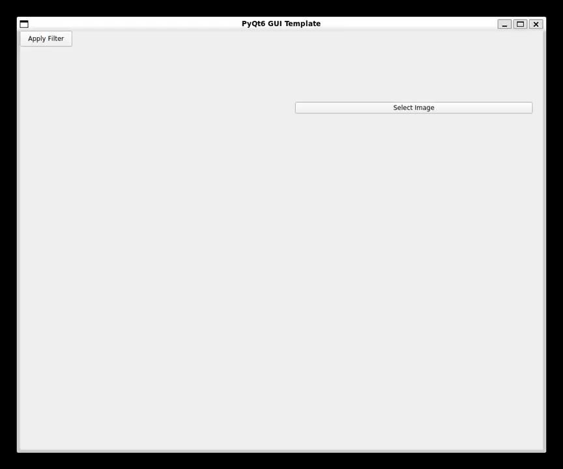
GUI Demo

Slide 23
Approach

Slide 24
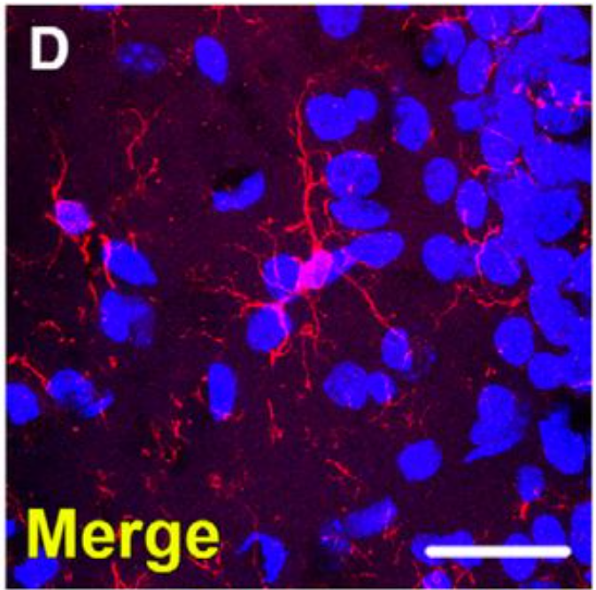
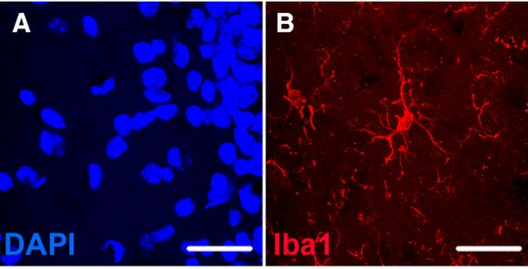
Technologies
Test-driven development
-test_image_filtering_and_cleaning.py
-test_image_preprocessing.py
-test_adaptive_thresholding.py
-test_analysis.py
-test_segmentation.py
Packages
import numpy, pandas, matplotlib.pyplot
import shutil
import os
import unittest
import tempfile
Import cv2
McGill, B. E., Barve, R. A., Maloney, S. E., Strickland, A., Rensing, N., Wang, P. L., Wong, M., Head, R., Wozniak, D. F., & Milbrandt, J. (2018). Abnormal microglia and enhanced inflammation-related gene transcription in mice with conditional deletion of Ctcf in Camk2a-Cre-expressing neurons. Journal of Neuroscience, 38(1), 200–219. https://doi.org/10.1523/JNEUROSCI.0936-17.2017

Slide 25
Technologies
Test-driven development
-test_image_filtering_and_cleaning.py
-test_image_preprocessing.py
-test_adaptive_thresholding.py
-test_analysis.py
-test_preprocessing.py
-test_segmentation.py
Packages
import numpy, pandas, matplotlib.pyplot
import shutil
import os
import unittest
import tempfile
Import cv2
Packages (PyQt6)
from PyQt6.QtCore import pyqtSignal, QThread, pyqtSlot, QObject.
from PyQt6.QtGui import QImage, QPixmap
from PyQt6.QtWidgets import (QApplication, QWidget,
QVBoxLayout, QPushButton, QLabel,...)
GUI
-ModelHandler.py
-CentralNode.py
-FunctionHandler.py
-ImageHandler.py
-MainWindow.py

Slide 26
What we wish we knew…

Slide 27

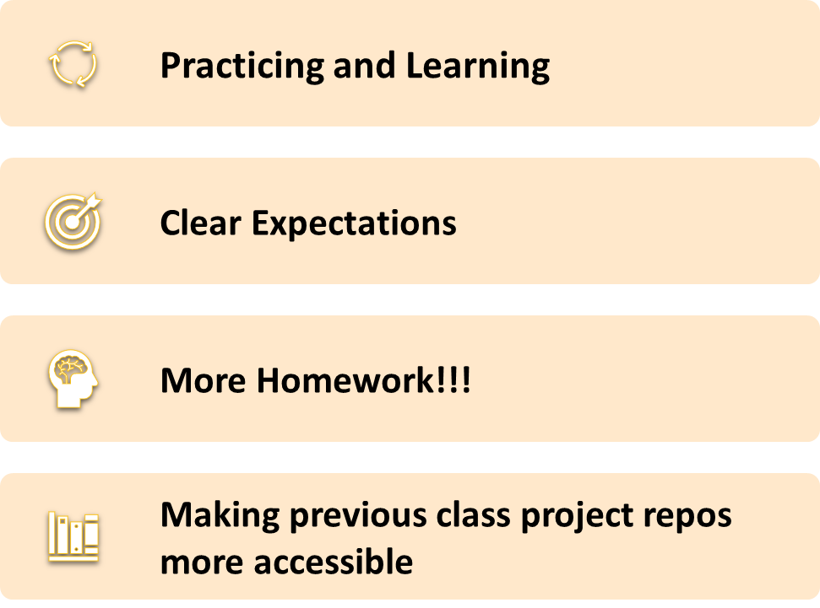
What we wish we knew

Slide 28
What we wish we knew
GitHub
-Branching and pull requests
-Setting up actions
Practicing and Learning
-More homeworks for practice
-Set clear expectations up for final repo and presentation earlier in the quarter
-Making previous years’ projects available
Design
-More examples on user stories, use cases, and components that are related to code
-More formal direction on expectations for these
AND MOST IMPORTANTLY….
Don't touch the screen!!

Slide 29
Land Acknowledgement
At the University of Washington, we work, learn, and teach on the land of the Coast Salish peoples, which touches the shared waters of all tribes and bands within the Suquamish, Tulalip and Muckleshoot nations. We pay our respect to this land, its shared waters, and those who have been stewards of this land throughout generations into present day and we honor with gratitude the Indigenous peoples who actively create, shape, and contribute to our communities.

